Slide 1
Building Public Libraries for the Future
P. Jayarajan

Slide 2
The global scene
Why public libraries,
when one can get everything from the net ?
when they are unable to meet the new expectations of the public ?
when their use is diminishing progressively ?
The Final Nail: Too costly to maintain: can’t afford anymore!

Slide 3
One prediction
The Forbes magazine published an article in 2012 titled ‘’Will public libraries become extinct?’’, by Marc Bodnick
His answer was ‘’ YES’’
He predicted that there would be a major decline in 5 years (by 2017) and within 15 years they will be GONE (by 2027)

Slide 4
The global scene: number of public libraries
Country | Libraries | Population | Lib/Population
China | 3,100 | 141 crores | 4,55,000
Australia | 1,631 | 2.41 crores | 15,000
USA | 9,000 | 33 crores | 37,000
UK | 3,500 | 7 crores | 20,000
Canada | 600 | 4 crores | 70,000
Singapore | 26 | 56 lakhs | 2,20,000
India | 50,000 | 127 crores | 25,000

Slide 5
Public libraries in the UK
 | 2003/4 | 2016/17
Libraries | 4,600 | 3,500
Staff | 26,200 | 17,000
Expense | 1,000 m UKP | 900 m
Book stock | 110 m | 80 m
Book acquisition | 12 m | 9 m
Enquiries | 58 m | 41 m
Book issues | 340 m | 240 m
Membership | 15 m | 8.4 m
Visitors | 336 m | 250 m

Slide 7
...... UK
Since 2010 about 500 libraries have been closed
More to follow......!
More than 550 libraries are now being managed by volunteers and owned by local community
‘’Take over or face its closure’’ !!

Slide 8
Public libraries in USA
In a recent article in New York Times, a Sociologist Eric Kenneberg wrote ‘’To restore civil society, start with the library: This crucial institution is being neglected when we need it the most’’

Slide 9
........ USA
He went on to write:
‘’In some cities, even affluent ones like Atlanta, entire branches are being shut down
‘’In San Jose, Calif., just down the road from Facebook, Google and Apple, the public library budget is so tight that users with overdue above $ 10 are NOT allowed to borrow books or use computers’’!

Slide 10
.
All is not lost!!

Slide 11
Story from Finland
A new library in Helsinki to be opened in December 2018
,
the library is being built to celebrate 100 years of Independence of Finland
located just in front of the Finnish Parliament
will probably be one of the most modern and state-of-the-art library in the world.

Slide 12
..... Finland
As far as public libraries are concerned, Finland is far ahead of all others
spends the equivalent of about Rs 5,000 per capita on public libraries annually
about 80 % of Finland’s population are members of its public libraries
even university libraries are thrown open to the public for use
the number of library visits and items borrowed per capita is among the highest in the world.
no wonder the Finns are the most happiest people in the world as per the latest World Happiness Report!

Slide 13
Story from China
Tianjin Binhai library opened recently
Spread over five floors and having area of more than 360 lakh sq ft with its stunning design is unique in many ways.
This much written about library, the Chinese proudly claims to be ‘’the futuristic library’’

Slide 14
Two diametrically opposing views
An image of a neglected institution, with inadequate governmental support and funding, progressively declining use, demotivated staff and compromised quality of service . ....disturbing and negative picture | A forward looking service, well used, with innovative service delivery, playing unique and growing role in the knowledge economy, and offering enhanced digital services. ......promising and positive picture

Slide 15
.
Where India stands?

Slide 16
.
Main Strengths /Opportunities
Public support
Huge number
Own buildings, well located in prominent places
Library acts in many states
Mention in the Constitution
RRRLF
National Mission on Libraries
IPLM (Indian Public Library Movement)

Slide 17
.
Weaknesses/Threats
Too traditional
Lag behind technology application
Huge unreached population
Low use
Inadequate funding
Too basic, even to call many ‘’library’’
Lack of awareness about benchmark
No credible data
Lack of a national policy

Slide 18
.
Some recent positive developments

Slide 19
Establishment of the National Mission on Libraries in 2012
............based on the recommendations of
the National Knowledge Commission (2005)

Slide 20
The National Mission on Libraries
Public library survey
Creation of National Virtual Library of India
Training and Capacity Building of Public library staff
Development of model public libraries

Slide 21
Indian Public Library Movement (IPLM)
IPLM , funded by Bill and Melinda Gates Foundation
hosted by NASSCOM Foundation
managed by IPLM Secreteriat
The project started 5 years ago
Working in a few states
Working through partners
Public library leadership programme, managed by MSSRF
Have been able to demonstrate what libraries can achieve!
IPLCs

Slide 22
.
Some recommendations

Slide 23
.
Governments, both central and states, should give higher priority to public library development and take conscious and determined decisions to invest in public libraries

Slide 24
.
Every library, including the smallest one, should have internet access and at least one computer. The larger ones should have adequate number of computers and other accessories, to enable users to access internet and digital resources

Slide 25
.
Rural libraries are the most neglected and most underfunded. A special scheme should be initiated with special funds to develop libraries in rural areas.

Slide 26
.
All activities and programmes public libraries undertake should support the plans and programmes of governments at different levels, national, state and local. In fact, there should be a built in mechanism to re-orient every activity and programme so that they support and work hand in hand with the governmental programmes.

Slide 27
.
The per capita annual expenditure by the country as a whole is about Rs 15 per capita. This should be enhanced to Rs 100 in five years time. The corresponding figure for UK is about Rs1,000 per year, USA about 2,000 and Finland about Rs 5,000.
True, as per the Constitution of India, ‘’Libraries’’ is a state subject. But if public libraries in India has to go for the much needed transformation, a major intervention by the central government only can make that happen. The current level of expenditure by the central government is too inadequate.

Slide 28
.
Government to frame a comprehensive and forward-looking national policy on public libraries at the earliest.

Slide 29
.
jayarajan45@gmail.com
9605183684

Slide 30
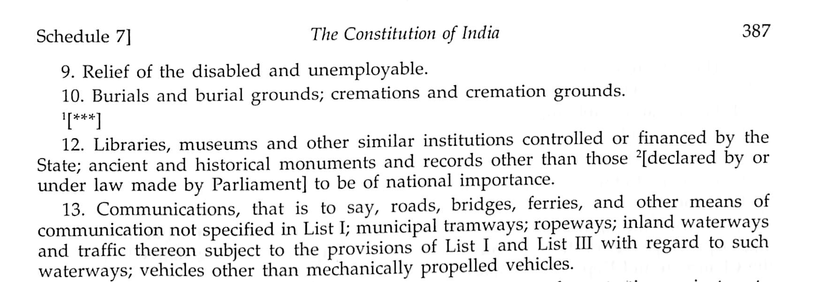
Constitution of India, LIST II– STATE LIST
State List

